Slide 1
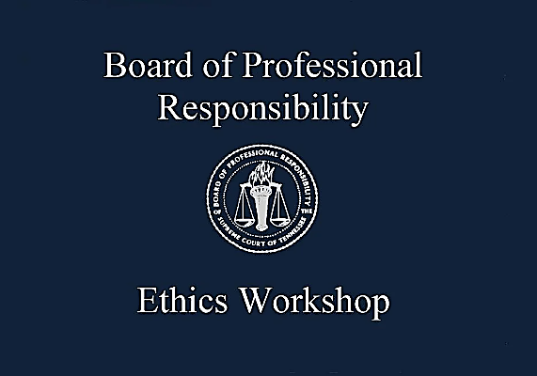

Slide 2
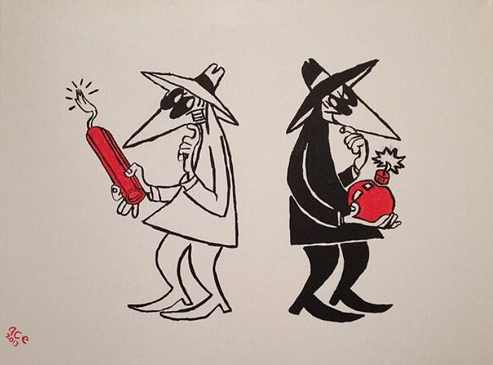

Slide 3
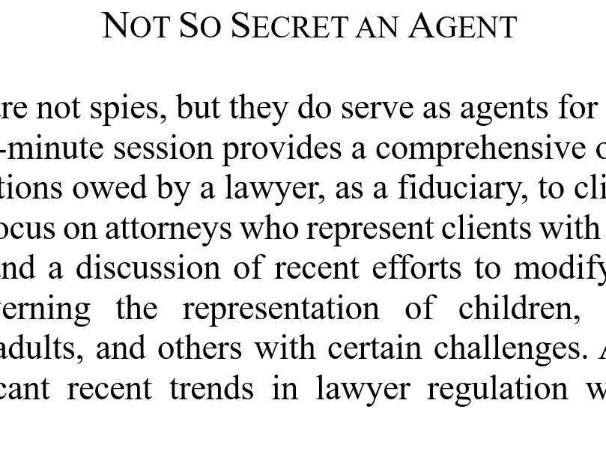

Slide 4


Slide 5
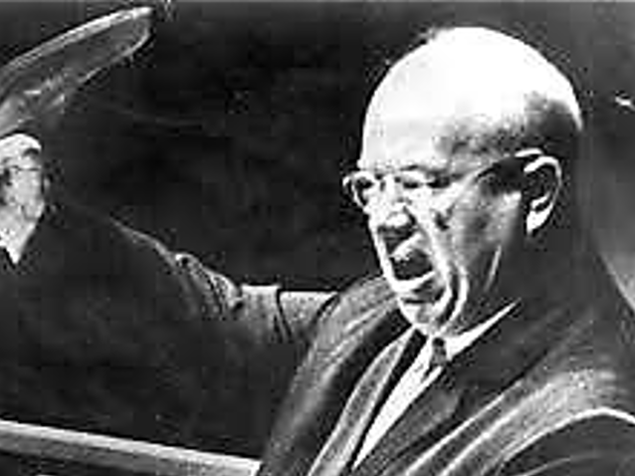

Slide 6
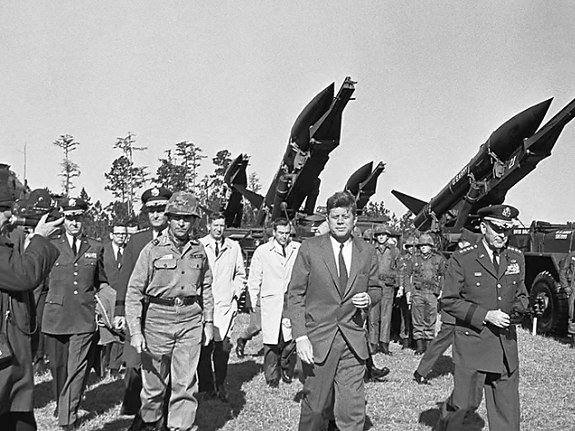

Slide 7


Slide 8
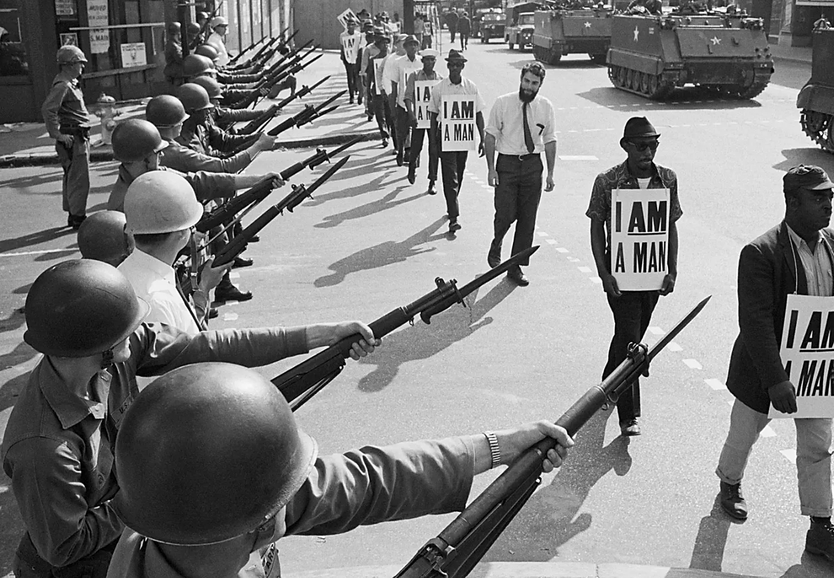

Slide 9
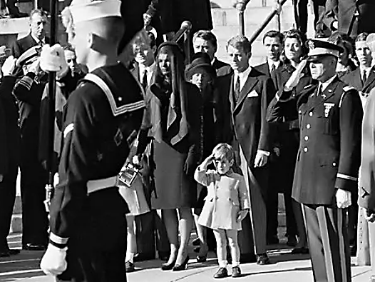

Slide 10
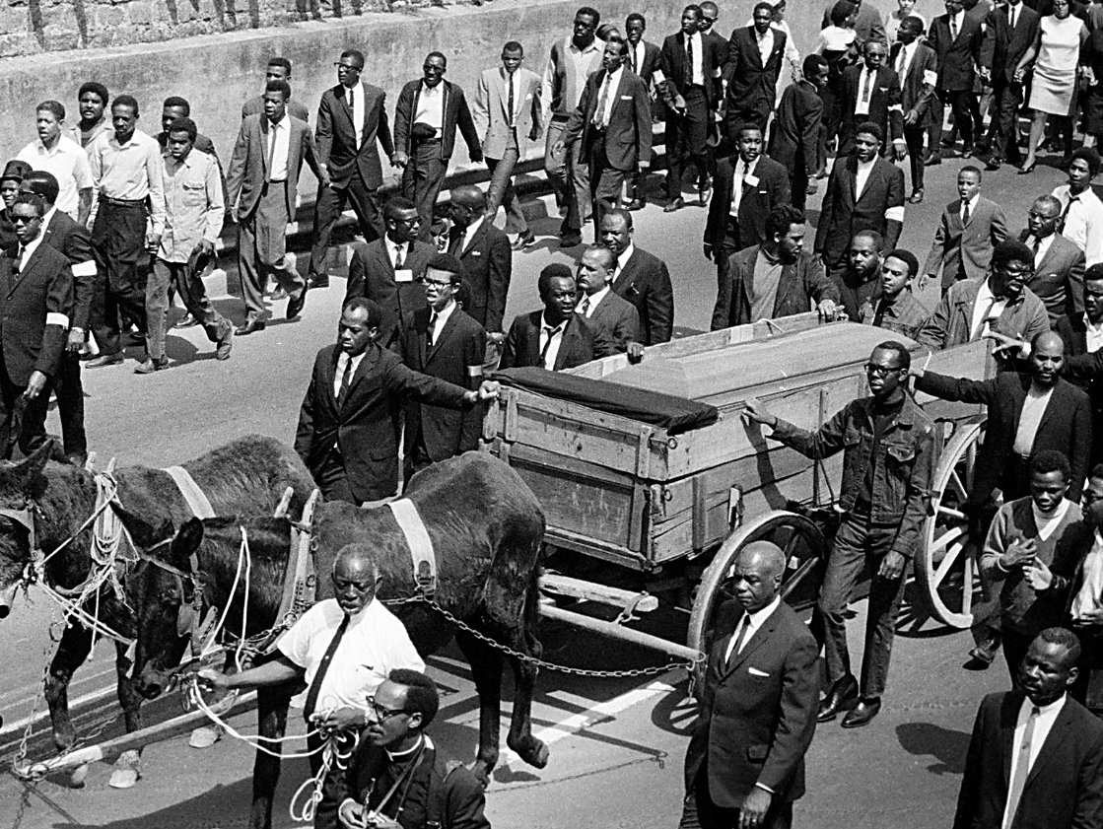

Slide 11
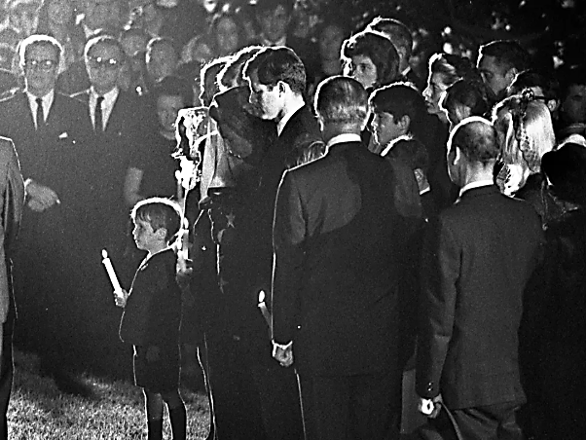

Slide 12


Slide 13


Slide 14

.

Slide 15


Slide 16


Slide 17
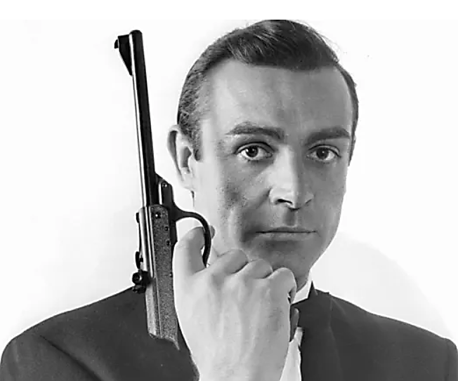

Slide 18
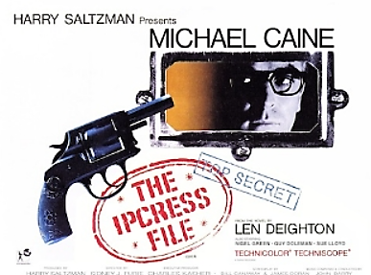

Slide 19
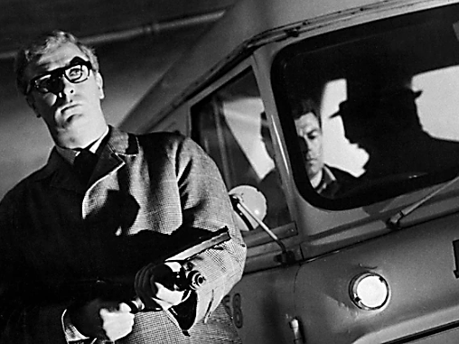

Slide 20


Slide 21
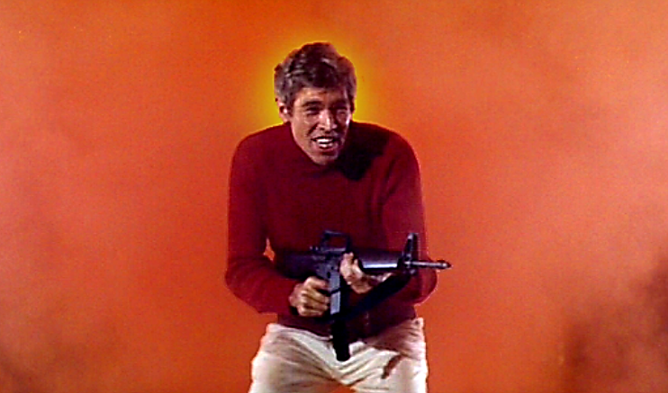

Slide 22
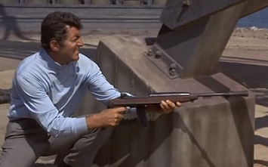

Slide 23


Slide 24


Slide 25


Slide 26


Slide 27


Slide 28
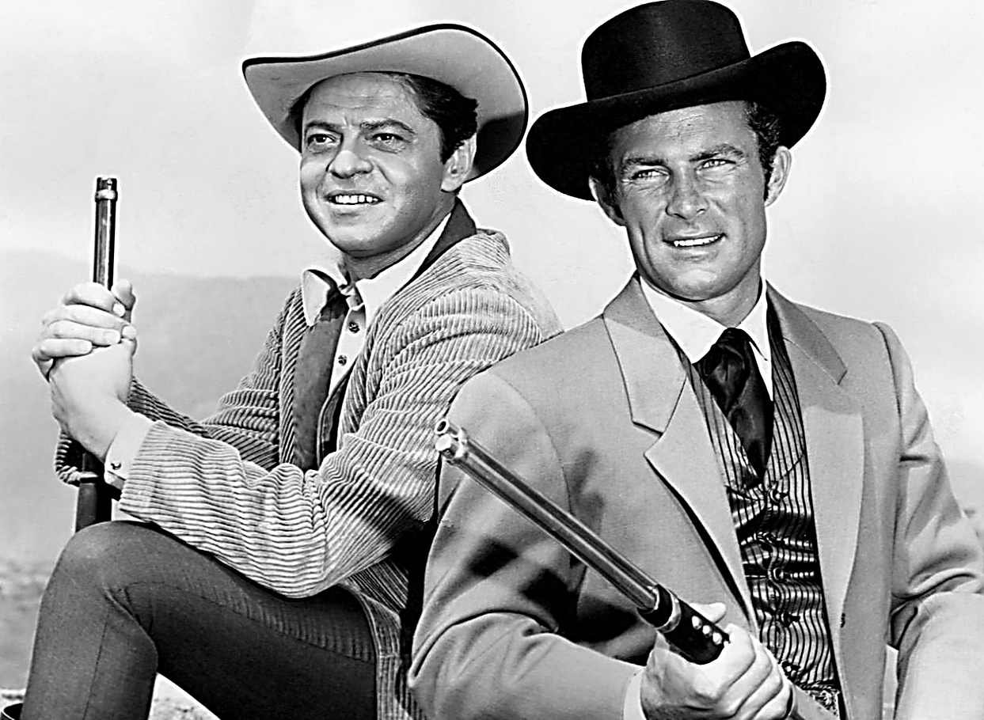

Slide 29


Slide 30
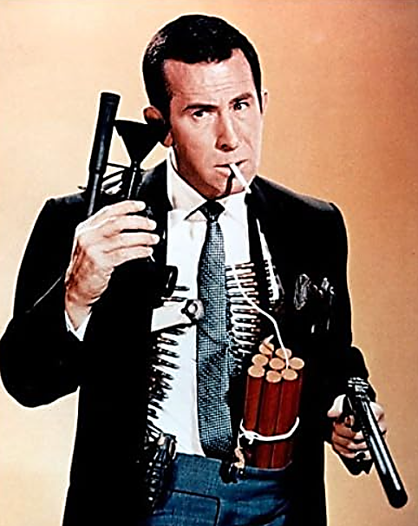

Slide 31


Slide 32
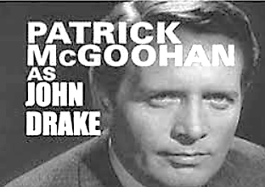

Slide 33
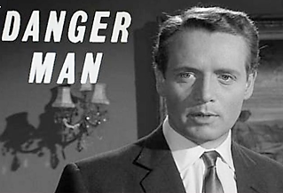

Slide 34


Slide 35



In the Matter of Douglas James Crawford
D2017-30 (USPTO Jan. 25, 2018)

Slide 36
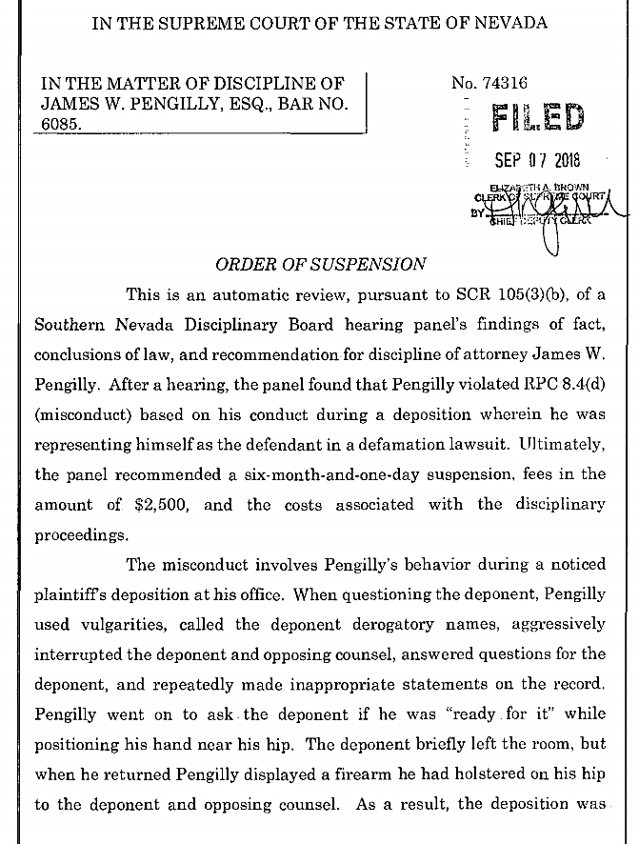
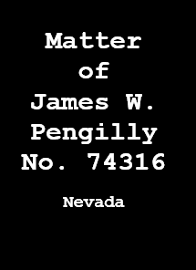
.
.

Slide 37


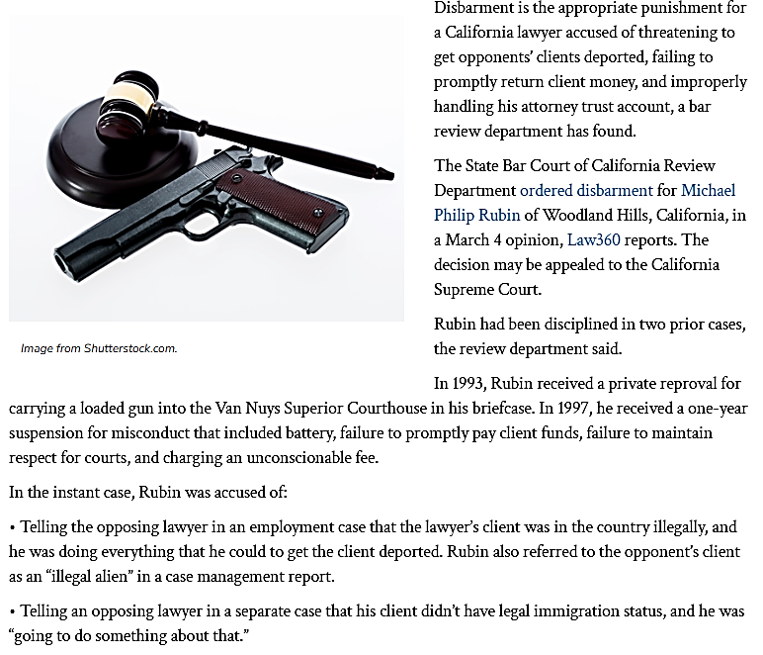

Slide 38
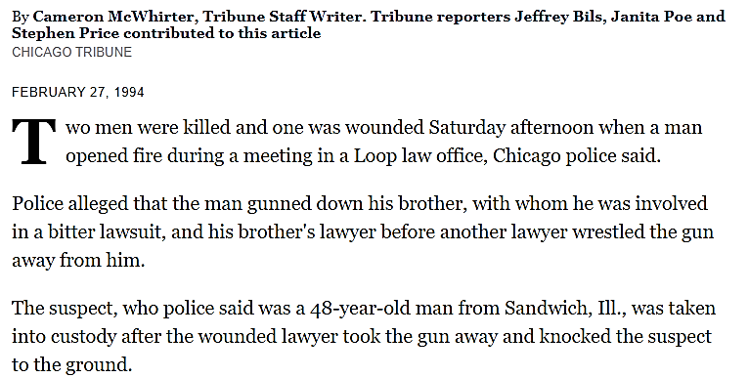

Slide 40
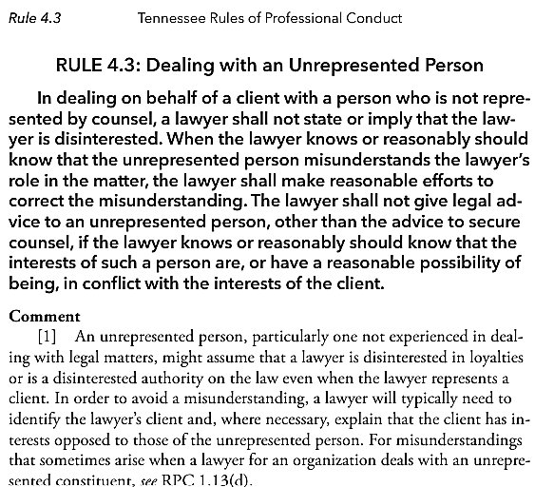

Slide 41
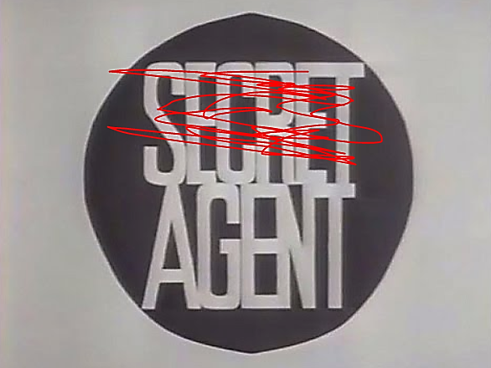

Slide 42
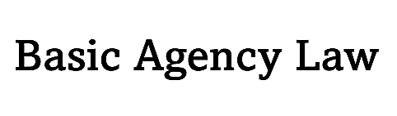

Slide 43
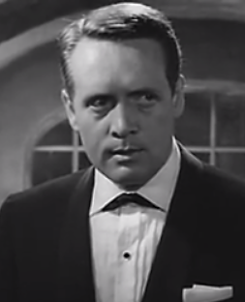
.
AGENCY
Lawyer client relationships are one of agency;
The lawyer is the agent & the client is the principal;
Generally, an agent can bind a principal regardless of the principal’s true position in a matter.

Slide 44

.
3 Types
of AUTHORITY
EXPRESS
Client gives lawyer explicit directions
(e.g., “enter this not-guilty plea for me in a preliminary hearing”).

Slide 45
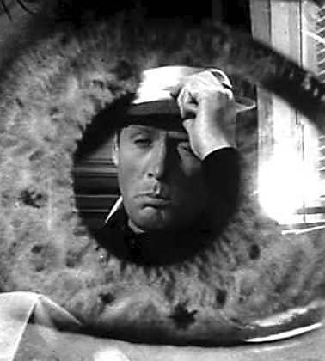
.
IMPLIED
Client gives general instructions permitting an attorney to take certain actions
(e.g., creating papers necessary for a house closing).

Slide 46
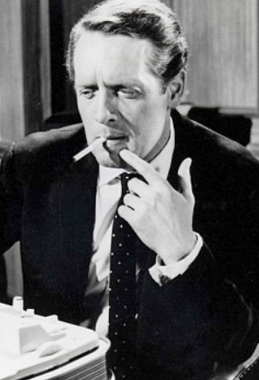
.
3. APPARENT
Where principal tells 3rd person that agent has authority; &
Where agent has no express or implied authority; &
Where 3rd person relies on lawyer’s actions/representations; or
Where principal places agent in a position that allows 3rd person to have a reasonable belief that agent has express authority;
CONDUCT of agent binds principal!

Slide 47
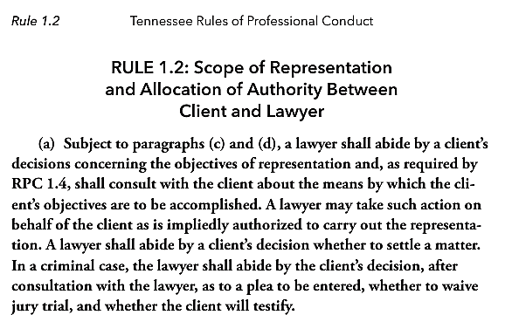

Slide 48
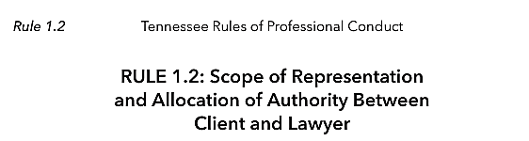


Slide 49


Slide 50
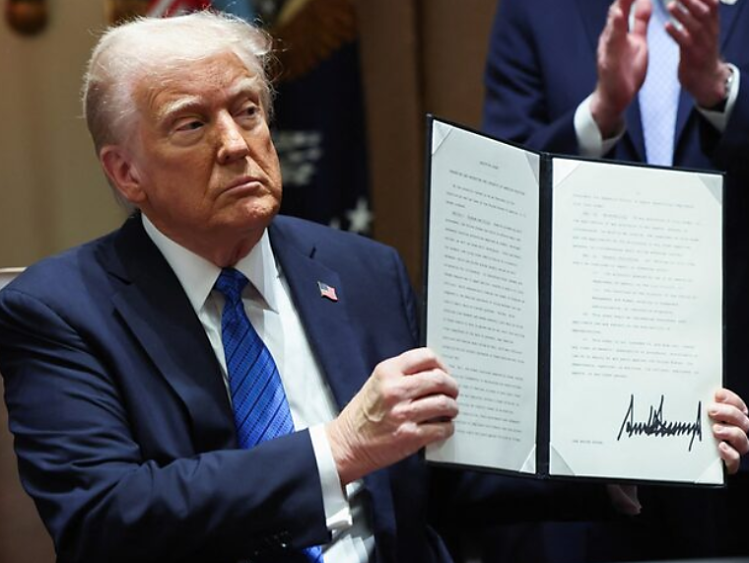

Slide 51
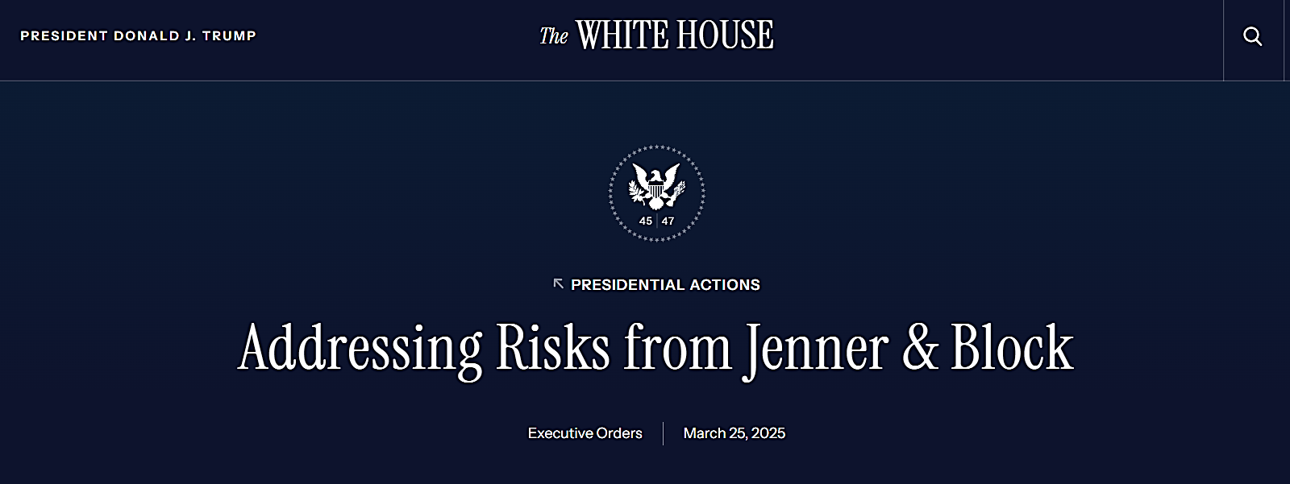

Slide 52
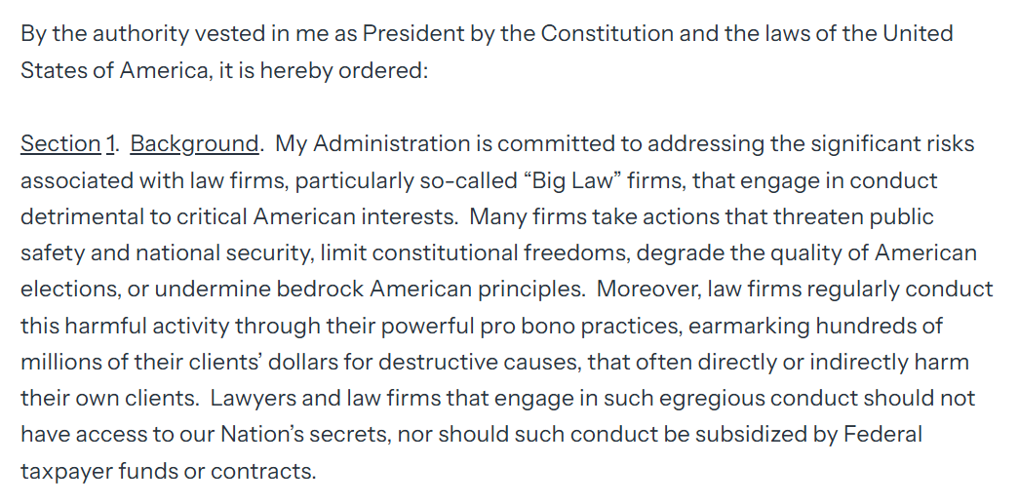

Slide 53
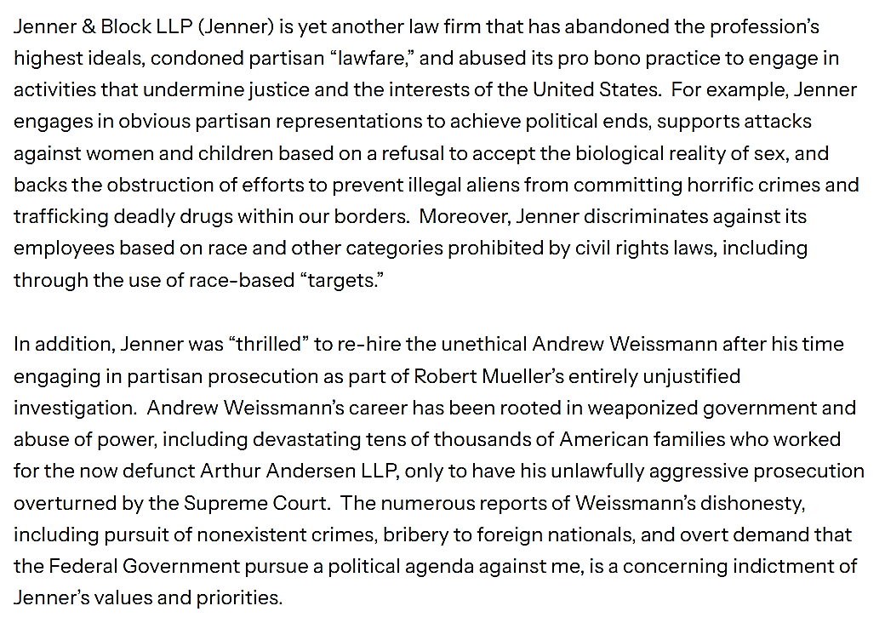

Slide 54

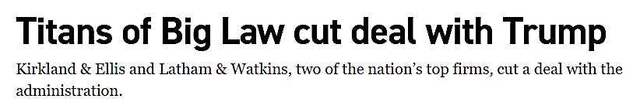
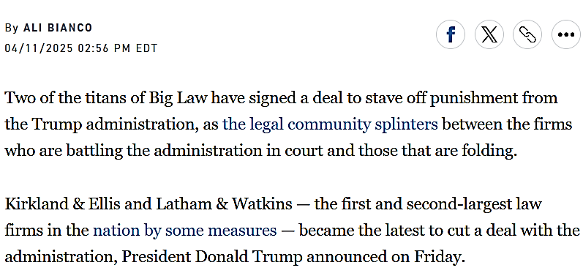

Slide 55


Slide 56
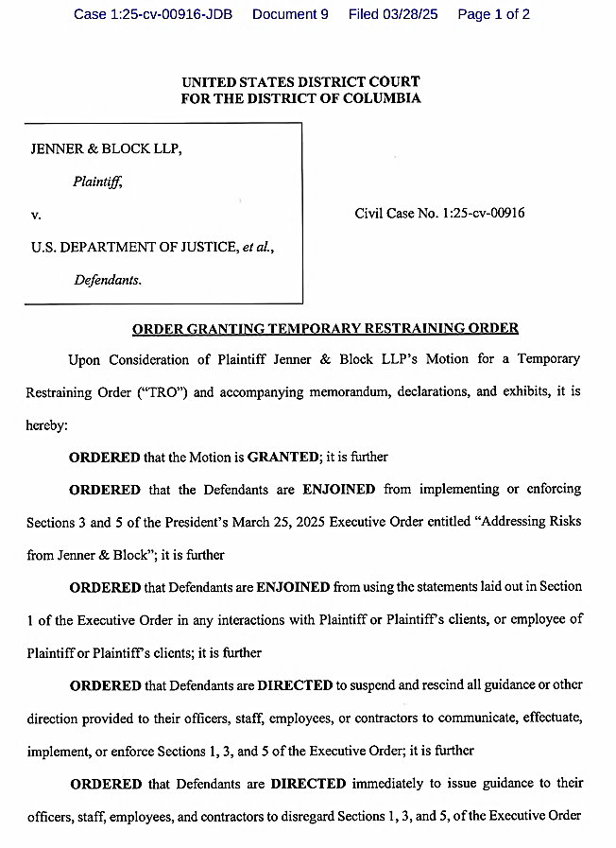
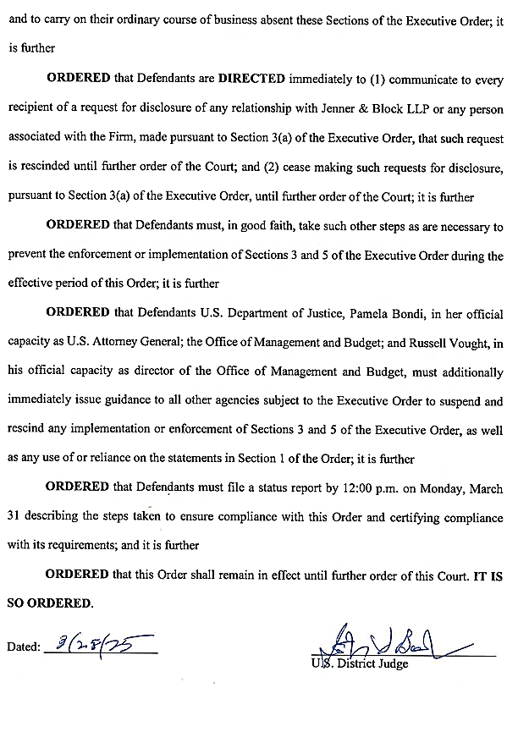

Slide 57
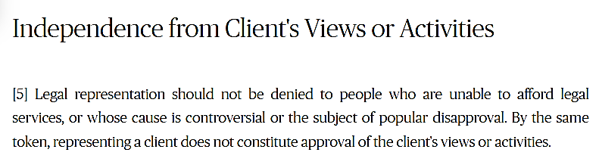

Slide 58
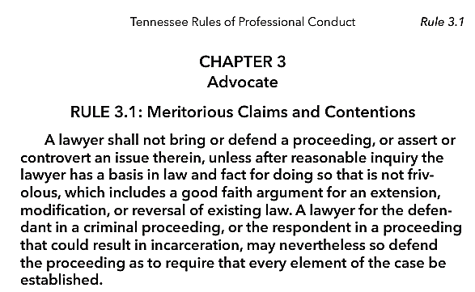

Slide 59

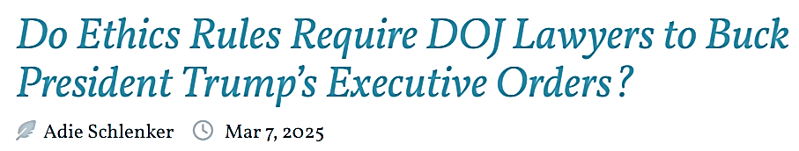


Slide 60
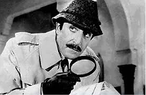


Slide 61
The Nullity Doctrine
The Doctrine Deprives Otherwise Legal Acts of Their Effects and Renders Those Acts Void or Voidable.
e.g., Non-Lawyer CEO of a closely-held corporation, files suit to collect corporate debts in small claims court…Nullity Doctrine applies as only a duly authorized agent, an attorney, is allowed to represent the corporation in court.

Slide 62
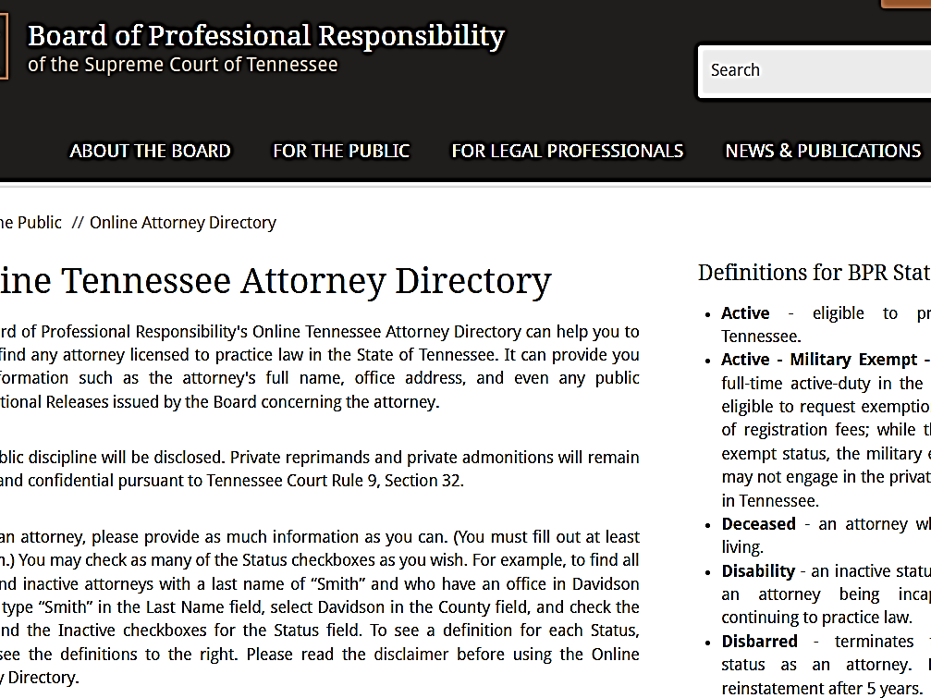

Slide 63
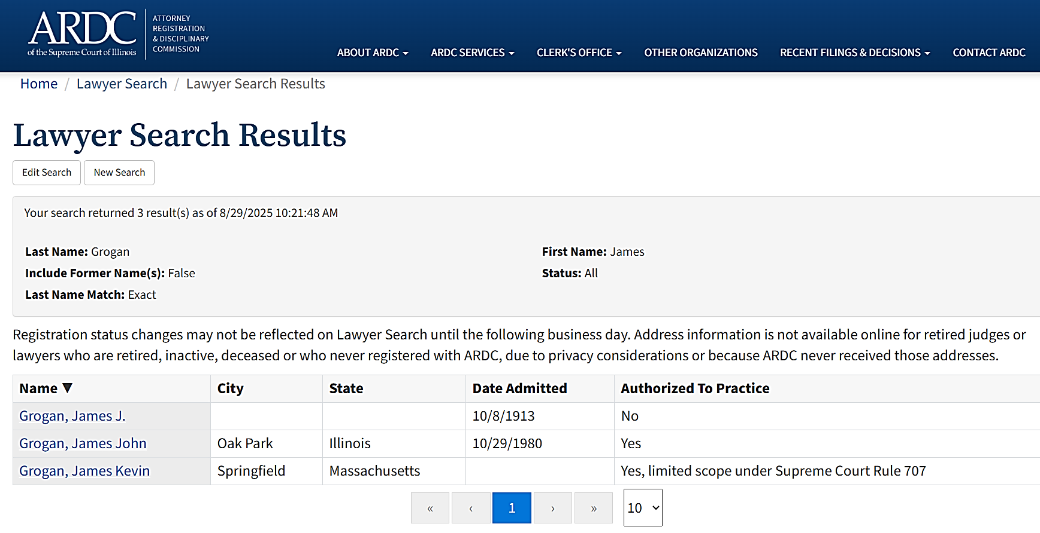

Slide 64


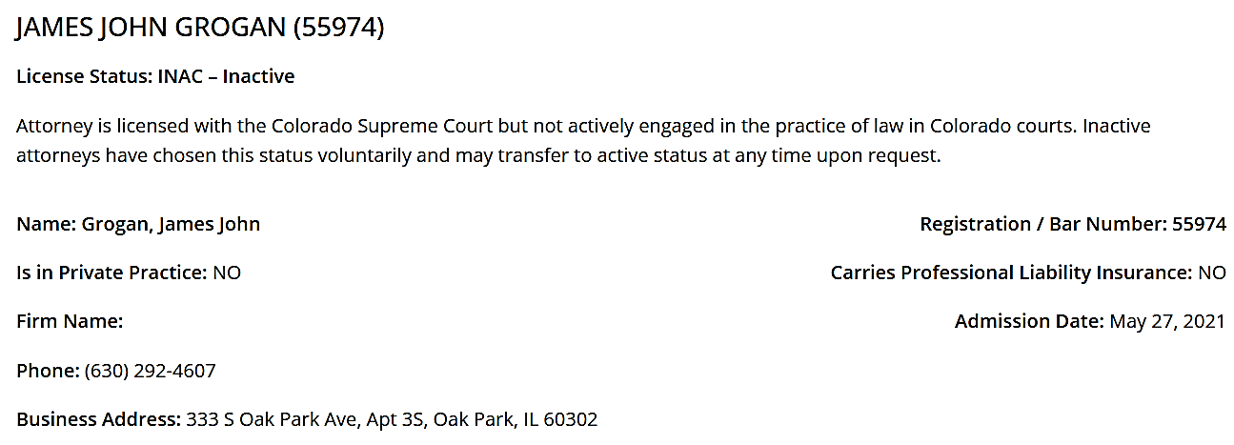

Slide 65
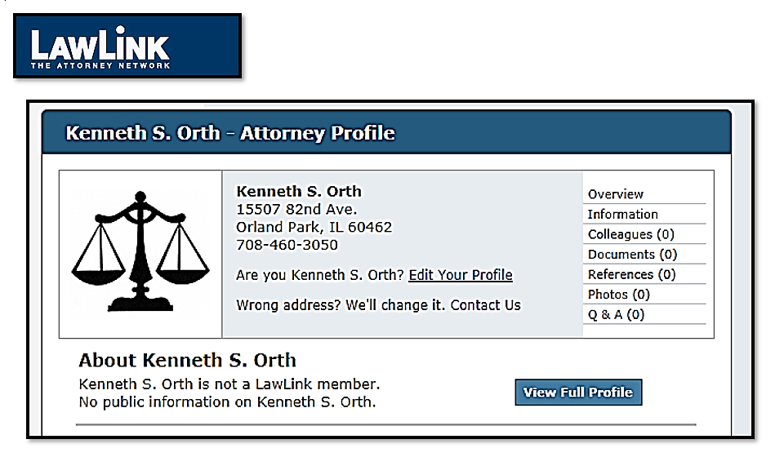

Slide 66
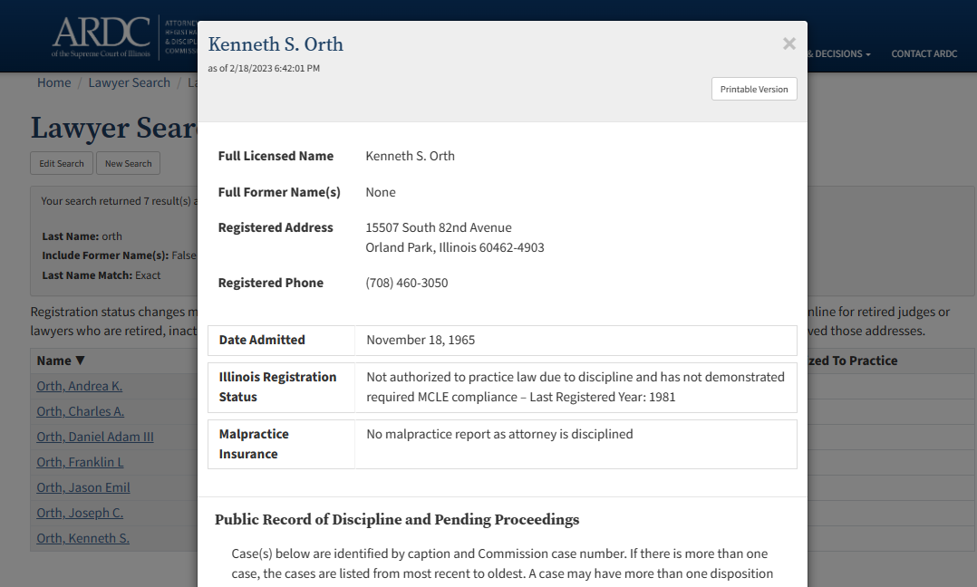

George Janiczek v. Dover Management Co.
.

Slide 67
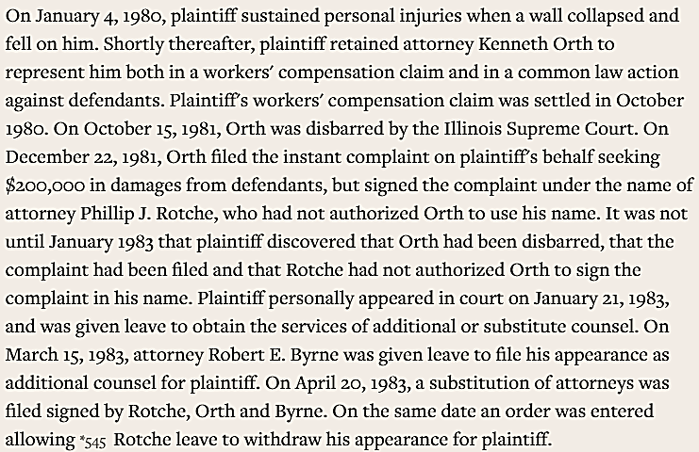
George Janiczek v. Dover Management Co.
134 Ill.App.3d 543, 481 N.E.2d 25 (1985)

Slide 68
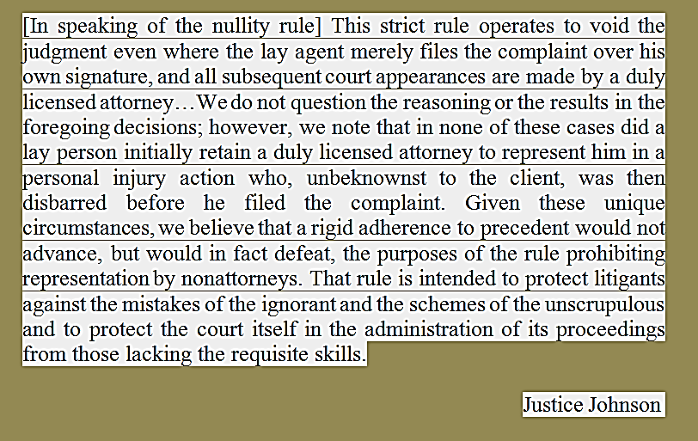
George Janiczek v. Dover Management Co.
134 Ill.App.3d 543, 481 N.E.2d 25 (1985)

Slide 69

Michael Applebaum, Special Admin. Estate of Joseph Applebaum, Deceased v. Rush University Medical Center,
No. 105905 (Ill. Nov. 20, 2008)

Slide 70

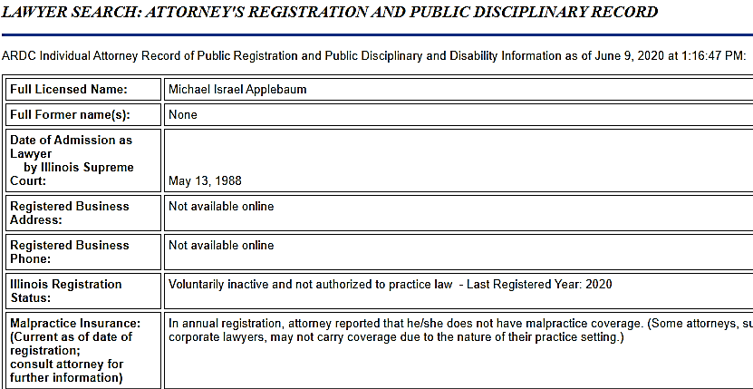
Michael Applebaum, Special Admin. Estate of Joseph Applebaum, Deceased v. Rush University Medical Center,
No. 105905 (Ill. Nov. 20, 2008)
.

Slide 71


Michael Applebaum, Special Admin. Estate of Joseph Applebaum, Deceased v. Rush University Medical Center,
No. 105905 (Ill. Nov. 20, 2008)

Slide 72



Slide 73


Slide 74







Slide 75


Slide 76
5 Necessary Elements to Establish an Advice of Counsel Defense
Before taking action;
Client, in good faith, sought advice from an Attorney whom Client considered competent;
For the purpose of securing advice on the lawfulness of the Client’s possible future conduct;
Client made a full and accurate report to Attorney of all material facts of which the Client knew; &
Client acted strictly in accord with advice of Attorney, who had been given a full report.
NOTE: A crucial element in the defense is that defendant secured advice on the lawfulness of possible future conduct.

Slide 77

.

Slide 78


Slide 79

.

Slide 80

.

Slide 81


Slide 82

4
Core
Duties
Competence
Candor
Communication
Diligence

Slide 83


Slide 84



Slide 85


Slide 86


Slide 87


Slide 88



Slide 89


Slide 90


6th Amendment, Assistance of
Counsel Clause

Slide 91
6th Amendment
The Sixth Amendment’s right to effective assistance attaches directly to the fidelity and competence of defense counsel’s services, regardless of whether counsel is appointed or privately retained.
Sixth Amendment
Rights of Accused in Criminal Prosecutions
https://www.congress.gov/content/conan/pdf/GPO-CONAN-2017-10-7.pdf

Slide 92



Slide 93


Slide 94


Slide 95
The Strickland Test
Was the lawyer’s performance deficient, meaning was it so fundamentally defective so as to require a reversal of a conviction or a sentence?
2. Did the deficient performance prejudice the defendant, i.e., is there a reasonable probability that the result would have been different?

Slide 96

The Strickland Test

Slide 97


Slide 98


Slide 99


Slide 100


Slide 101


Slide 102

.

Slide 103



Slide 104



Slide 105



Slide 106


Slide 107

McCoy v. Louisiana
.

Slide 108


Slide 109




Slide 110


Slide 111


.

Slide 112
Non-Delegable Client Decisions
Whether to Plead Guilty;
Whether to Waive the Right to a Jury Trial;
Whether to Testify on One’s Own Behalf; &
Whether to Forgo an Appeal.

Slide 113


Slide 114


Slide 115


Slide 116


Slide 117






Slide 118



Slide 119


Slide 120


Slide 121


Slide 122


Slide 123



Slide 124



Slide 125


Slide 126


Slide 127


Slide 128


Slide 129


Slide 130


Slide 131



Slide 132




Slide 133


Slide 134


Slide 135


Slide 136


Slide 137


Slide 138


Slide 139
Gary Mark Gilmore
In 1976, Gilmore murdered a gas station attendant in Orem, Utah and the next day shot to death a motel manager in Provo, Utah;
State Police apprehended him, and he was put on trial for two murders;
Psychiatrists said that he was not insane at time of the shootings;
His 2 court appointed lawyers rested without calling witnesses;
Jury returned guilty verdict and recommended death;

Slide 140
Gary Mark Gilmore
Gilmore chose not to appeal/seek habeas relief;
His mother, Bessie, sued for a stay of execution as her son’s “next friend.”
U.S. Supreme Court declined to review, holding the record established a knowing and intelligent waiver of appellate review;
ACLU sought, and obtained, several stays of execution;

Slide 141



Slide 142


Slide 143


Slide 144


Slide 145


Slide 146


Slide 147


Slide 148



Slide 149


Slide 150


Slide 151


Slide 152



Slide 153



Slide 154


Slide 155















Slide 156


Slide 157


Slide 158


Slide 159



Slide 160


Slide 161


Slide 162


Slide 163


Slide 164


Slide 165



Slide 166


Slide 167


Slide 168


.

Slide 169

.

Slide 170


.

Slide 171


Slide 172
The Role of the Government Lawyer:
Two Approaches
The Public Interest Approach: Under certain circumstances, a government attorney must stand up to a client in the interest of a larger client – what the attorney perceives to be the proper service of the law, the public interest, or morality (Weinstein & Crosthwait).
The Agency Approach: An agency attorney acts unethically when she substitutes her individual moral judgment for that of a political process which is generally accepted as legitimate (Geoffrey P. Miller).

Slide 173


Slide 174
The Role of the Government Lawyer: Additional Thoughts
“The current ethical rules of the fifty states are unsatisfactory when applied to government attorneys because they mandate certain behavior while failing to take into account the constitutional and statutory powers and duties imposed upon government attorneys.” (Maureen A. Sanders); &
“The agency approach and the public interest approach are both valid models of government lawyer ethics. However, the agency approach is better suited to the advocate or litigator, and the public interest approach is better suited to the advisor.” (Jesselyn Radack).

Slide 175



Slide 176




Slide 177


